Slide 1
Challenges in Testing, Instrumentation and Monitoring of River Valley Projects
V.M.Sharma FNAE, FIGS, FISRMTT
Director Aimil, New Delhi

Slide 2
Need for Testing
Assessment of site conditions by individuals based on their past experience can be subjective.
It is difficult for a third party to say how good is ‘good’ or how bad is ‘bad’.
First we need to test and quantify the required parameters in the laboratory and at site, and
Then modify these parameters to take other factors into account such that these parameters become representative of the site conditions and can be used in the designs.

Slide 3
Assumptions
We make sweeping assumptions to simplify the complexities of the analysis and design, for example we assume that the rock mass is
Homogeneous
Isotropic
Linear elastic
No hysterisis in repeated loading

Slide 4
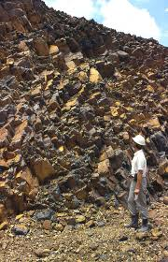
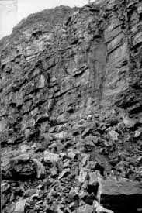
Actual rock masses are not homogeneous

Slide 5
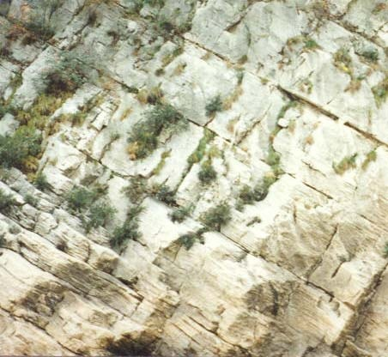
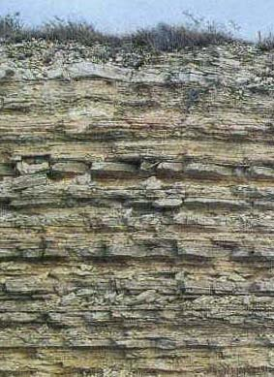
Not isotropic

Slide 6
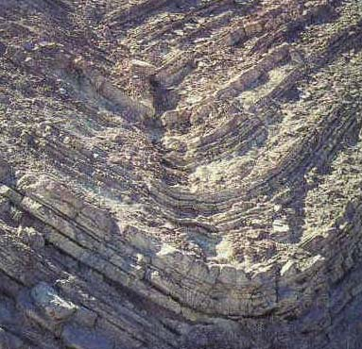
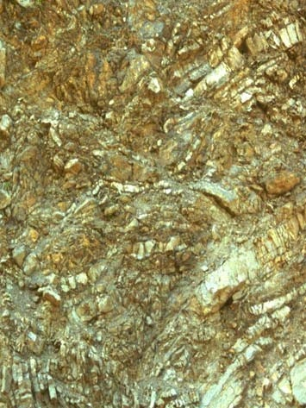
There are folds in the rock masses

Slide 11
Design parameters required
Strength and deformation characteristics of the rock masses are required.
Shear strength of the rock masses and the interface of rock and concrete are required as design inputs.
In-situ stresses are required for the design of tunnels and the underground caverns.
Complete geometry and strength characteristics of the interfaces are required

Slide 17
Undisturbed sampling
Should retains the true in-situ structure and water content of the soil.
The stress changes can not be avoided.
However,there should not be any change due to disturbance of the soil structure, so also
No change in void ratio and water content,
No change in constituents and chemical properties.

Slide 18
Challenges in laboratory testing
Drilling through sandy gravelly materials.
Drilling through boulders is difficult.
Drilling through weak rocks – triple tube cores ?
Collection of undisturbed samples is difficult
Rock material can be sampled but sampling of rock joints, interfaces, shear zone materials ?
Test samples do not follow the stress path at site
Complete stress –strain curve required at times.

Slide 19
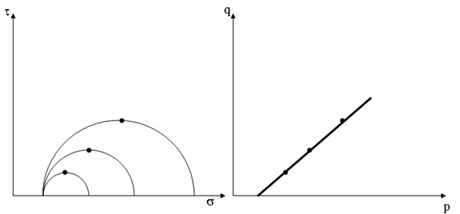
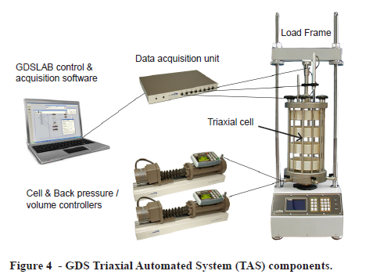
stress path testing

Slide 20
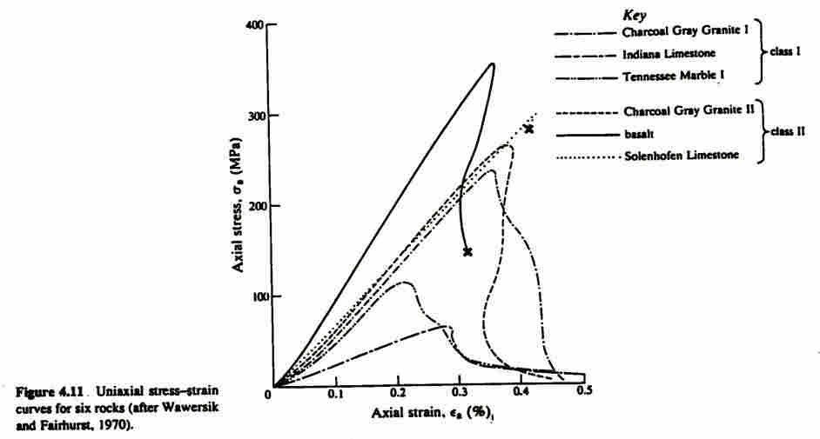
Closed loop servo controlled machines

Slide 21
Testing in the laboratory
Rock samples are tested for uni-axial loading condition which is not representative.
True triaxial testing is more representative.
Test procedure causes changes in properties.
Video techniques like IMETRUM are desirable
Grips and end conditions create distortions
Effect of saturation, creep, fatigue, strength after failure needs is required in some cases

Slide 22
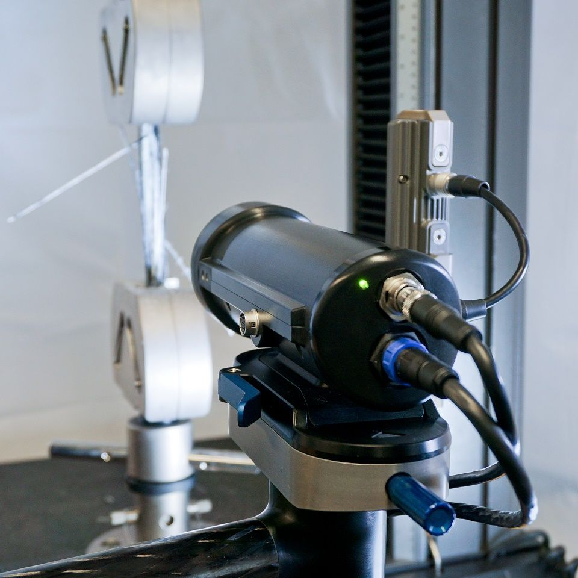

Slide 23
The patented software makes it possible
iMetrum have developed & patented specialist software that measures movement in materials and structures highly accurately in real time.
The system is a point to point and full-field optical measurement system - they use pattern recognition technology and sub pixel interpretation of video images – i.e. non-contact.

Slide 24
Other precautions required
Preparation of samples not given importance.
Sides of the sample are wavy at times.
Ends are not flat and not perpendicular to axis
Sample axis should be vertical, parallel to the loading direction.
Saturation of samples is very important.
Rate of loading affects the strength.
Sample size commensurate with the grain size.

Slide 25
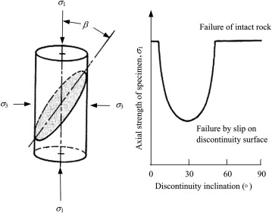
Orientation of weak planes affects the strength drastically

Slide 26
Field Testing
Tri-axial testing of rock masses is seldom taken up because of the cost and time involved.
Hoek and Brown criterion is generally used which has never been tested on the ground.
Preparation of rock blocks with chisel and hammer causes disturbance and damages
Measurement of in-situ stresses is seldom carried out correctly.

Slide 27
In-situ stresses
In-situ stresses are required as an input parameter for the design of tunnels and underground caverns
Stresses in the tunnel periphery get modified.
Some of the test locations are close to the valley where principal stresses are not vertical. As per ISRM 15ᵒ to vertical is the limit
Hydraulic fracture created for the test should be vertical, only then the equations are valid.

Slide 28
Hydro-fracturing
In Himalayan region, the rocks are already fractured, creating new fractures not required.
Existing fractures can be opened with water pressure for measurement of stresses.
Technique of reproducing fractures on thermo-elastic films needs improvement.
Measurement of stresses by opening existing fractures is probably the best at present.

Slide 29
Instrumentation
It must be recognized that tunnels cause three dimensional changes at the face and some deformation takes place in advance even before tunnel reaches that place.
If we want to measure the total deformation due to tunnel, drifts must be planned in advance, say for geological investigations and used subsequently for instrumentation.

Slide 30
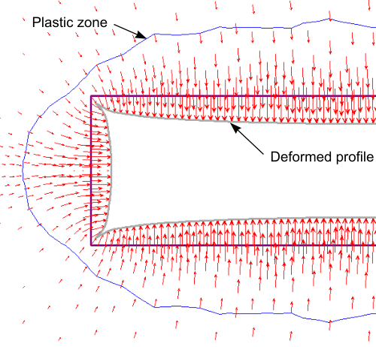
Deformations of tunnels on face

Slide 31
Instrumentation
Each instrument should have a purpose.
Properties of the material should not get altered by installation of foreign bodies.
Location and Orientation of instruments should be chosen carefully.
Lots of precautions are required during installation. Manual for piezometers 76 pages.
For example - calibrated instruments should not be touched by hand as it is temperature sensitive.

Slide 32
Grouted borehole extensometers are useless (do not work)
Holes are about 100 mm in size.
Tor steel anchors are 12 mm in diameter.
Anchors are connected with rods to the face.
Rods are covered with sleeves.
Other anchors end at different points
The whole assembly is grouted. Hinders mvmt
It is assumed that the anchor will transmit the movement of the rock to the face. Don’t.

Slide 33
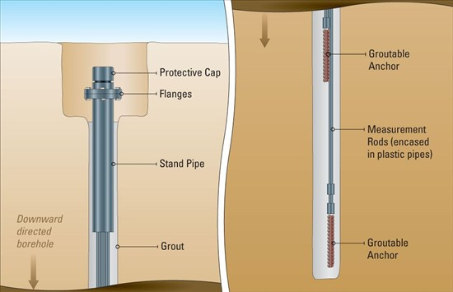
Groutable anchors and rods very popular, but does not work

Slide 34
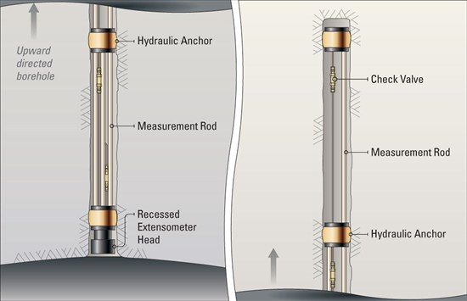
Hydraulic anchors

Slide 35
Instrumentation either not done or not interpreted properly
Teton dam : designed by USBR, most experienced
If you open the internet and look at the failure of Teton dam, you will find that the debate is still going on to find the exact reasons of failure
The reason why no instrumentation was provided in Teton dam was that the authorities thought there is nothing new to learn! The state of art knowledge was already available!!

Slide 36
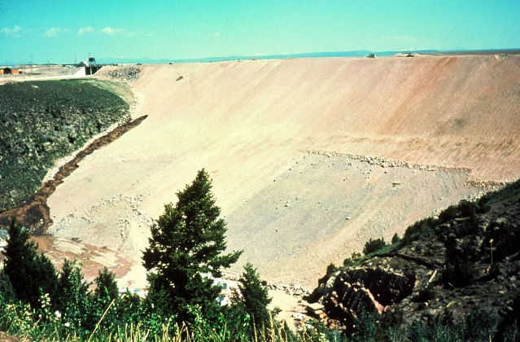

Slide 37
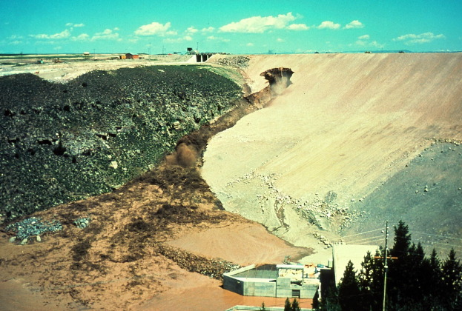

Slide 38
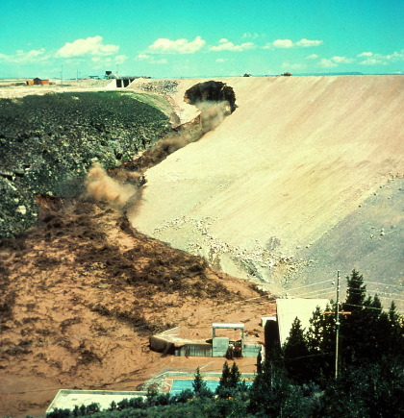

Slide 39
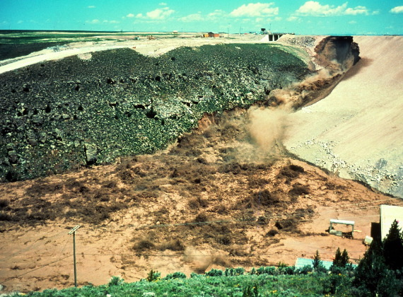

Slide 40
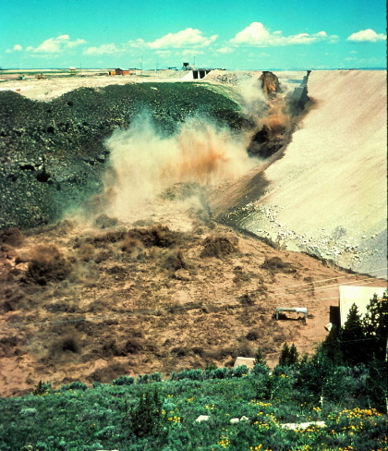

Slide 41
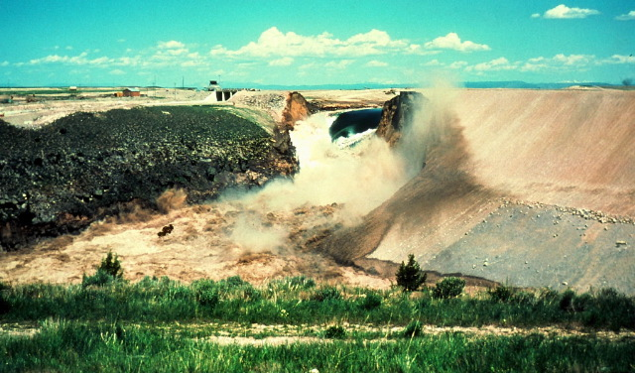

Slide 42
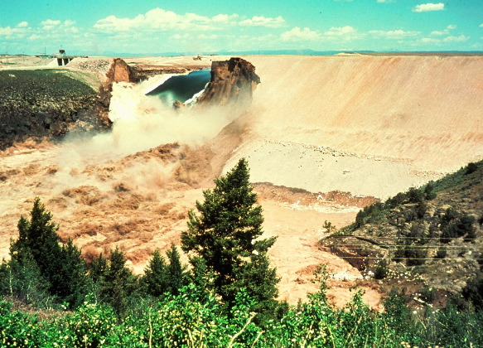

Slide 43
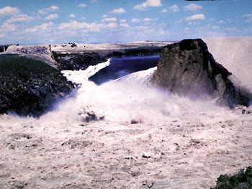

Slide 44
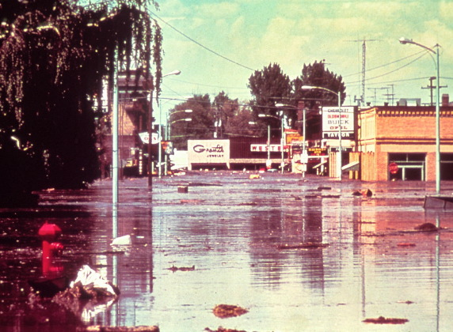

Slide 45
Possible causes
Silt core was compacted dry of optimum.
Fissures in the foundation were to be grouted.
The cracks were so wide that concrete had to be used to fill the voids.
Silt suffered collapse settlement reducing the vertical pressure of silt on grout cap, thus permitting hydraulic fracture.
Once water started flowing, silt eroded quickly

Slide 46
Exact reasons of failure of Teton dam not known
If you open the internet and look at the failure of Teton dam, you will find that the debate is still going on to find the exact reasons of failure
The reason why no instrumentation was provided in Teton dam was that the authorities thought there is nothing new to learn! The state of art knowledge was already available!!

Slide 47
Vajont dam
Very bold design – double curvature thin arch dam – height 262 m, base 27 m, top 3.4m.
There was landslide developing in the reservoir area and instrumentation was provided to monitor its movements.
The results showed that the movements increased with rise in the water level, but no appropriate action was taken.

Slide 48
EARLY SIGNS IGNORED
A movement monitoring system was in place and working
Throughout the summer of 1960, minor landslides and earth movements were noticed; however instead of heeding these warning signs, the Italian government chose to sue the handful of journalists reporting the problems for "undermining the social order."

Slide 49
Contd.
On October 9, 1963, before it had even been completely filled, an enormous landslide (the 2km-long scar of which can still be clearly seen) sent 260 million cubic meters of mountainside into the lake behind the dam, causing a wave of water 250 meters high to spill over into the valley

Slide 50
The Vajont Disaster
High up in the Italian Dolomite mountains, 90km north of Venice, the Vajont Dam was the scene of one of the 20th century’s worst engineering disasters. The tallest dam in the world when it was completed in 1959, at 262m, (27m at base, 3.4m at top) it was beset with problems from the beginning.
It was recent, was instrumented, yet failed

Slide 51
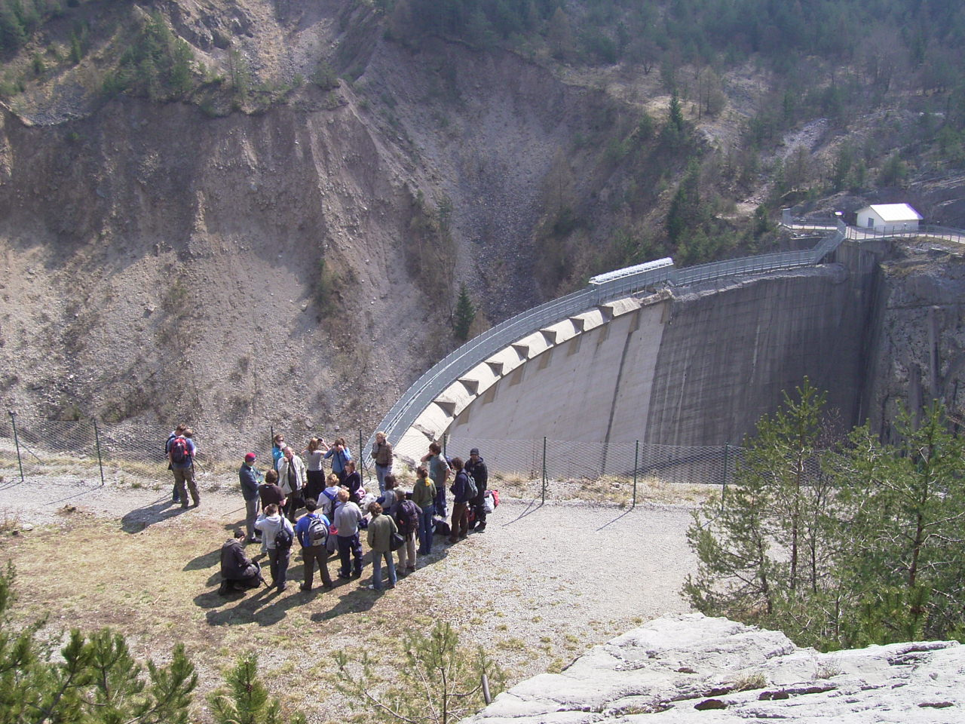

Slide 52
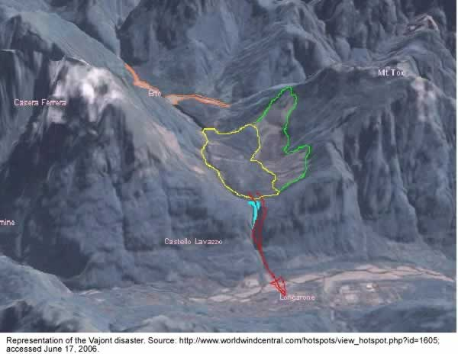

Slide 53
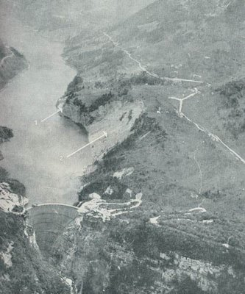

Slide 54
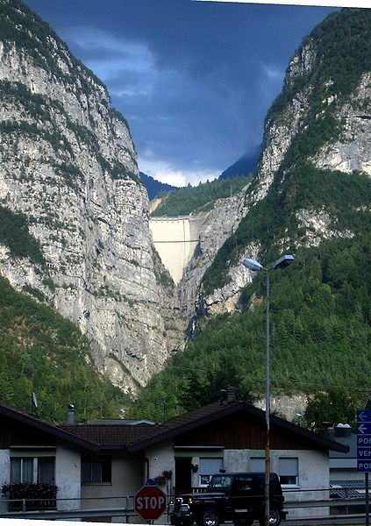

Slide 55
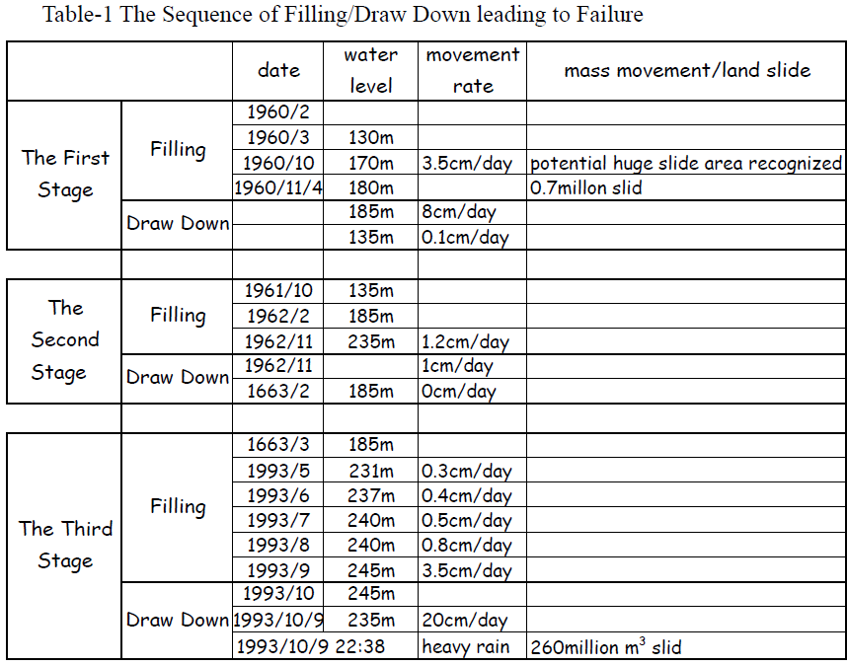

Slide 56
October 1960
The level reached 170m, a rapid increase in the rate of displacement 35 mm /day
Huge joint of 2km in length was found to open up in an area 1700 m by 1000 m
Level 180 Nov. 4th slide of 700,000 cum
Level lowered to 135 m, movement was reduced to 1 mm/day
Management studied data and allowed filling to be continued with monitoring

Slide 57
Reservoir was filled and slowly emptied three times
Third time a combination of drawdown and heavy rains triggered a big landslide of 260 million cu.m. of forest, earth and rock
Resulting splashed water caused 50 m cu.m. water to push up and destroy the village Casso located 260 m above FRL before overtopping concrete dam of 250 m

Slide 58
Analysis of the slide indicated
That it was caused by a combination of factors
Adverse geologic features in the reservoir area
Manmade conditions imposed by impounding water with bank storage affecting delicately balanced stability of a steep rock slope.
Progressive weakening of the rock mass with time, accelerated by excessive ground water recharge(excessive rains).

Slide 59
Damage
The water estimated to be about 30 million cubic meters, then fell about 500 meters on the downstream villages and killed 2500 persons.

Slide 60
Conclusions – Foundations
Mostly dams fail because of the foundations
Actual foundations of dams are FAR from homogeneous, isotropic, linear elastic etc..
Only an independent unit width slice, free from the rest, is considered – cantilever at base in gravity dams and no inter-slice forces in earthen dams assumed.
No foundation dam interaction considered

Slide 61
Conclusions- Testing
Field tests are time cumbersome and costly, hence either not done or not representative.
Drilling and sampling in sandy gravelly strata is difficult. Undisturbed sampling is a myth. There are less disturbed or more disturbed.
Test results obtained from the field and laboratory need to be moderated to take the size effect and variations in lithology and geologic structures into account.

Slide 62
Instrumentation
Lots of precautions are required to be taken during installation.
Properties of parent material must not change substantially
Only hydraulic anchors must be used with multiple point borehole extensometers.
It must be remembered that grouted anchors are useless and DO NOT WORK

Slide 63
Thank you for your patience
vmsharma@aimil.com 9810018167

